Slide 1
Sales pitch
Femke Hofman – Cora Impens

Slide 2
Content
Problem and solution
The product
Medium and strategy
Price
Why should u buy it?
Conclusion
Website

Slide 3
Problem
Absence of the receiver
left unattended
taken to a post office
delivered to local residents
Solution
Our product! Delivery is possible, even during absence

Slide 4
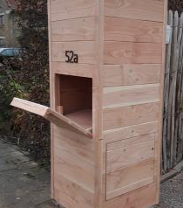
The product

Slide 5
The product
'Keora'
Target audience: people who regularly receive packages
Notes:
Naam en logo;
Afbeeldingen invoegen van de technische tekeningen + omkadering

Slide 6
Medium and strategy
Posters, flyers, commercials
New products for existing customers

Slide 7
Price
Expensive?
Different parts
Quality
€ 1945,04
Advantages

Slide 8
Why should u buy it?
Advantages
Disadvantages
1. Easy to use
2. Security > theft
3.For a lifetime
4. Notification
1. Quite large
2. Expensive

Slide 9
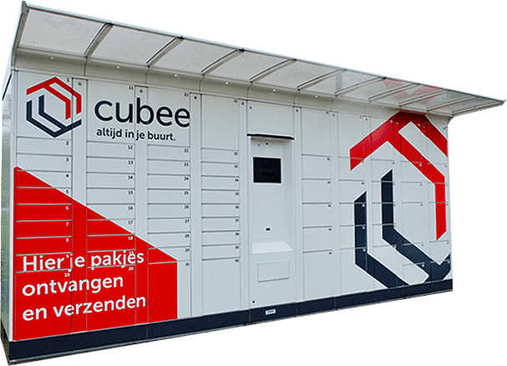
Conclusion
More advantages for deliverer and receiver than with B-Post cubee dispensers

Slide 10
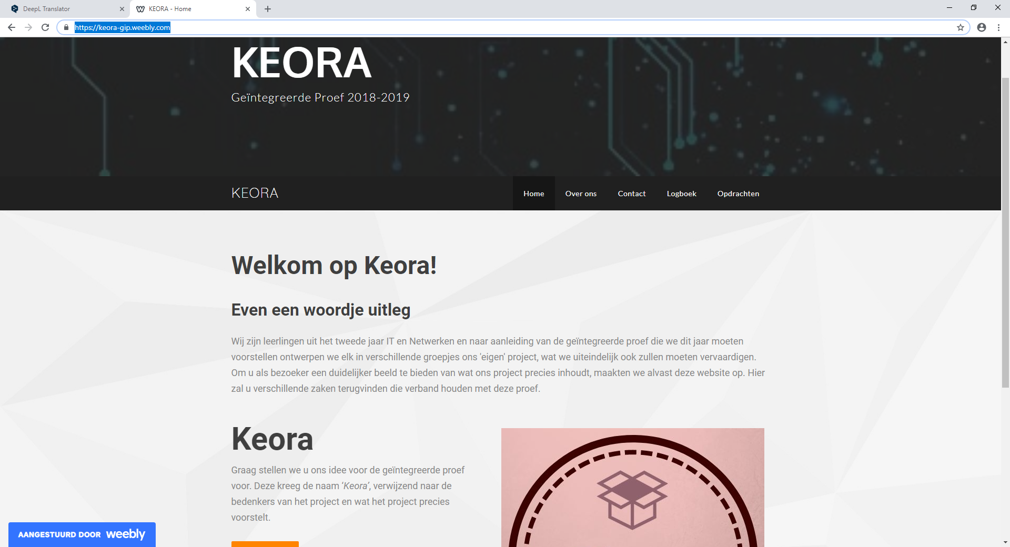
Website
https://keora-gip.weebly.com/

